Slide 1
How to use this template
This is a framework of how you can socialize the value of your ITAM organization and develop partnerships and investment to achieve your goals.
Leverage this PPT as a starting point
If you’ve done a POC or POV with Flexera, you can leverage those figures to build the current/future desired state overview.

Slide 2
ITAM Team Mission and Roadmap
Your Name
Date

Slide 3
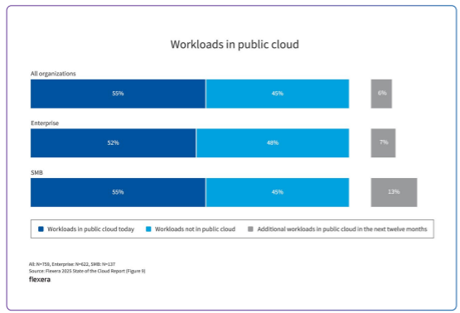
Why itam now – key technology trends
IT Procurement is distributed-across departments and buying models (direct/partner/pay as you go/marketplaces)
SaaS and AI have made sprawl worse
Cloud has enabled new licensing models – PAYG, BYOL
IT security is a growing concern
Cost of AI, cloud infrastructure and understanding ROI of these technologies keeps CIOs up at night

Slide 4
How trends are impacting [company]
What is your company experiencing as negative impacts?
Failed audits?
Unexpected renewals?
Blindly paying for vendor price increases?
Security incidents?
IT budgets increasing?
“Per-employee SaaS spend currently averages $1,562, a 51% increase since 2022. Gartner estimates that as many as 25% of provisioned [SaaS] licenses are not regularly used by employees. In addition, decentralized ownership and sourcing results in increased risk, as organizations are generally only aware of 40% of applications in use.” – Magic Quadrant for SaaS Management Platforms, 30 July 2025

Slide 5
Why itam now – key [company] goals
Examples of company goals that would drive the need for a solid ITAM program include:
M&A: Need to stay compliant, rationalize technologies and contracts and remove tech debt/risk
Wanting to go public – get SOC2 Type 2 compliant, and adhere to other regulatory standards
Strategic initiative to cut costs to fund investments in AI or improve margins
Focus on security due to recent cyber threats in the industry/recent breach
Other (one idea is to ask your favorite genAI tool how ITAM could help your organization achieve your company’s stated strategic objectives)

Slide 6
Key questions ITAM needs to answer
Risk
& Value
How risky is it?
Spend
Management
What is it costing me?
Importance of Data quality
Usage & Attribution
Who’s using it & how much?
Complete, Up-to-date Inventory
What do we have?

Slide 7
KPIs
Reduction in EOL/EOS/vulnerable assets
Elimination of license compliance risk
Removal of deny-listed (shadow) apps
Risk
& Value
% of contracts/inv/PO inventoried
Reduction of redundant contracts
Spend
Management
Importance of Data quality
% of licenses unallocated and % unused
Reduction in unused licenses/apps
Usage & Attribution
Complete, Up-to-date Inventory
% of environment inventoried

Slide 8
SCopes
Scopes can be technology domains (on premises, SaaS, cloud licenses, AI, containers, etc.) or organizational units (departments – assets owned by IT, owned by engineering, owned by BU, etc.)
For the audience it is good to highlight where your team plays/where they don’t so it is clear where there may be intersections of collaboration or other gaps to consider. For example, many organizations have implemented a FinOps practice that is responsible for reducing cloud infrastructure spend, but they may not be responsible for managing cloud license spend.
Your scope might depend on where you have the biggest knowledge gap.

Slide 9
Mapping it Asset data and process gaps
Where it runs
On-Premises
Cloud
Hardware
End user software
Datacenter Software
Cloud infrastructure
Cloud software
SaaS Software
Key Products
How it’s bought/ budget
Who manages
Management tools and processes

Slide 10
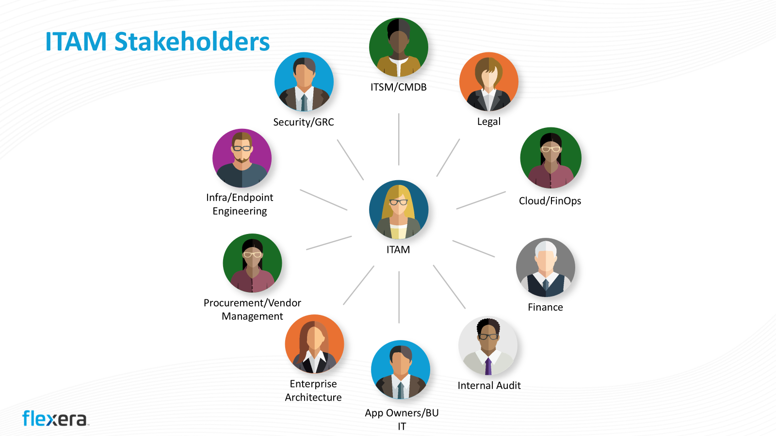
Gap analysis & scorecard
Current State | KPI/Scope | Future Desired State
 | % of environment inventoried
 | % of licenses unallocated and % unused
 | Reduction in unused/redundant apps
 | Reduction in # of redundant contracts
 | % inventory of contracts/Invoices and product use rights details
 | Reduction in EOL/EOS/vulnerable assets
 | Elimination of license compliance risk
 | Removal of deny-listed (shadow) apps

Slide 11
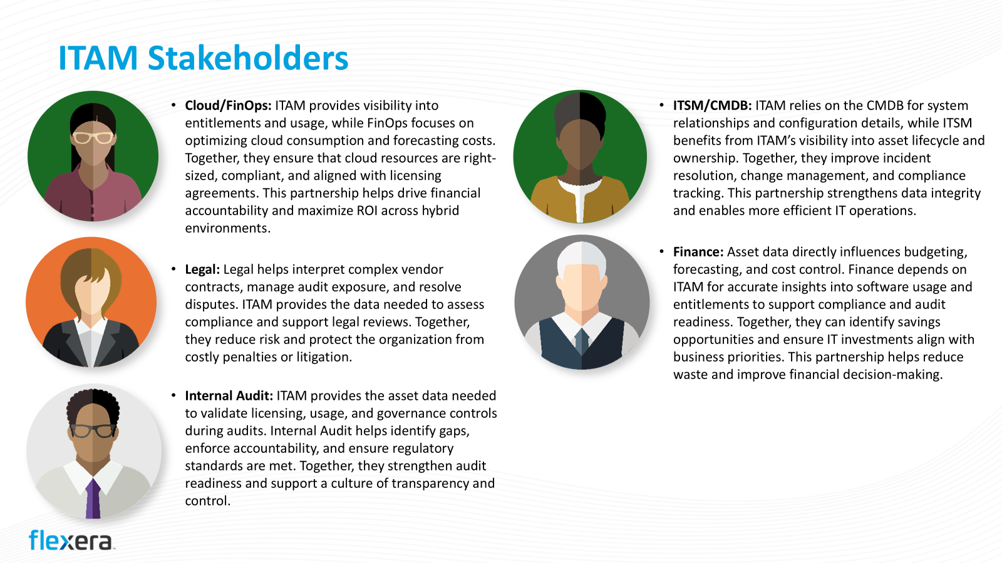
Priorities for closing the gap
Align roadmap priorities with what is going to align to business outcomes

Slide 12
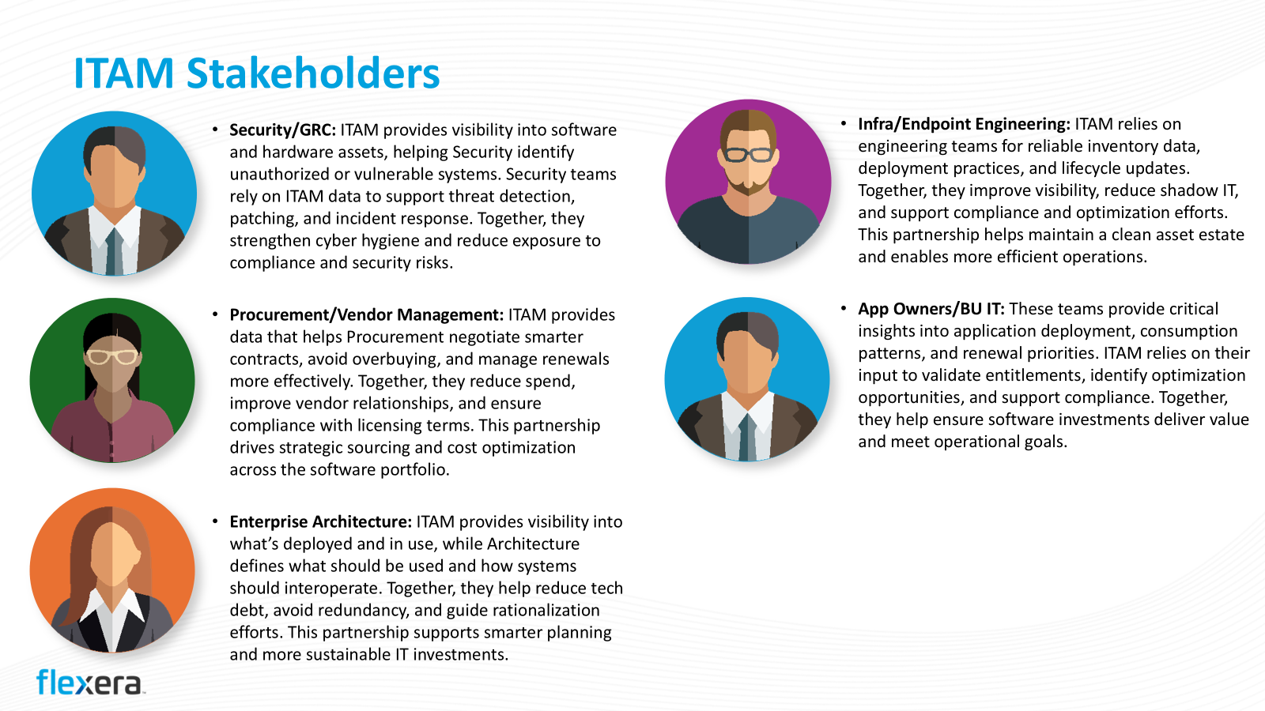
ITAM team org chart
Head of ITAM
Datacenter app focus
SaaS/end user compute focus
Cloud license focus

Slide 13
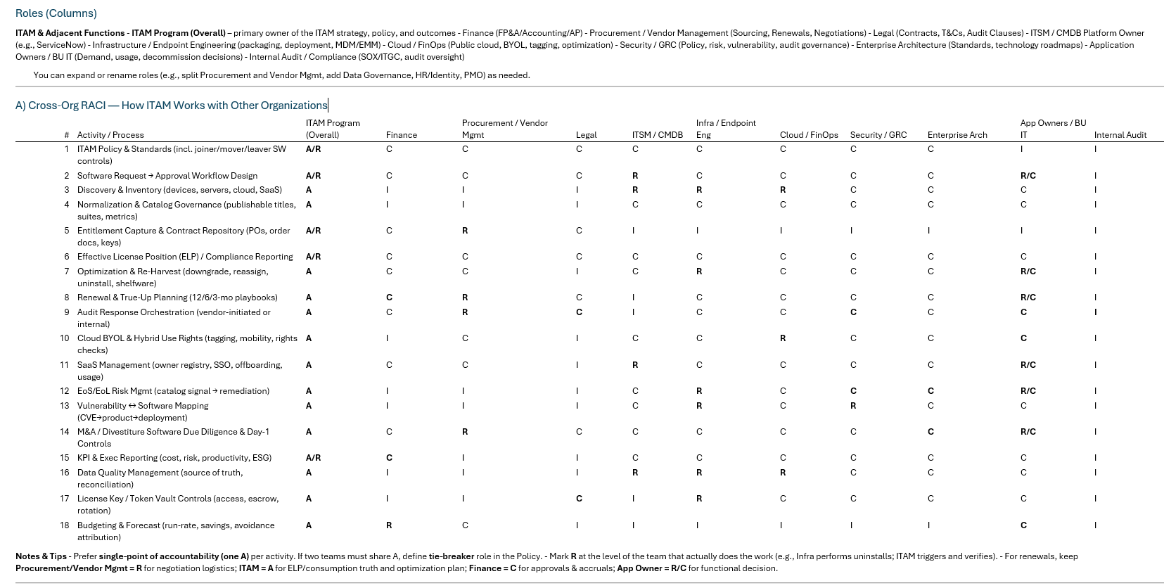
RACi – how we interact with others

Slide 14
example interaction
Team: Procurement / Vendor Management
Objectives: Best commercial outcomes; contract hygiene; renewal/no‑renewal decisions on time.
ITAM → Procurement: ELPs, optimization levers, consumption scenarios, risk ratings, walk‑away alternatives.
Procurement → ITAM: Contract copies, amendments, notices; renewal calendar; vendor intel; NDA/audit comms logistics.
Cadence: Weekly pipeline stand‑up; 12/6/3/1‑month playbooks per renewal.
SLAs: All renewals > $100k have ELP & options by T‑90; contract docs captured ≤ 5 business days from execution.
Artifacts: Renewal playbook, negotiation brief, options matrix, approval workflow.
Escalation: Commercial deadlock → Sourcing Director; policy exception → Legal + Finance.

Slide 15
example interaction
Security / GRC / IAM
Objectives: Reduce software risk (EoS/EoL, CVEs, shadow IT); enforce least privilege; audit trails.
ITAM → Security: Block/allow lists; EoS/EoL watchlist; software→CVE mappings; license vault access requests.
Security → ITAM: PAM/secret rotation policy; app control tooling; vulnerability priorities; JML controls.
Cadence: Monthly risk review; ad‑hoc for critical CVEs.
SLAs: High‑risk software removal ≤ 15 days (or per policy); license vault access approvals ≤ 2 BD.
Artifacts: Risk register, SBOM/SBOM‑light intake, access matrix, audit logs.
Escalation: Risk acceptance → CISO delegate.

Slide 16
Where we need your help
Do the priorities outlined in our roadmap reflect the needs of the organization?
Other areas where you need help on integrating

